Slide 1
Density Functional Theory
Structure, electronic and magnetic properties of materials
Summary
Magnetic
Structure
Electronic
Junfei Ding

Slide 2
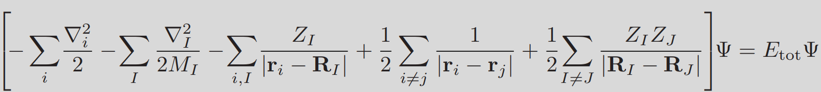

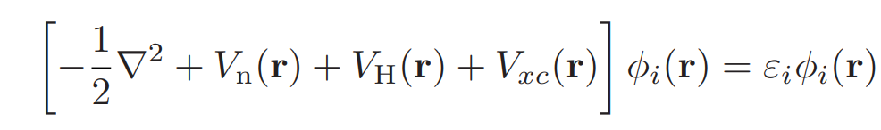
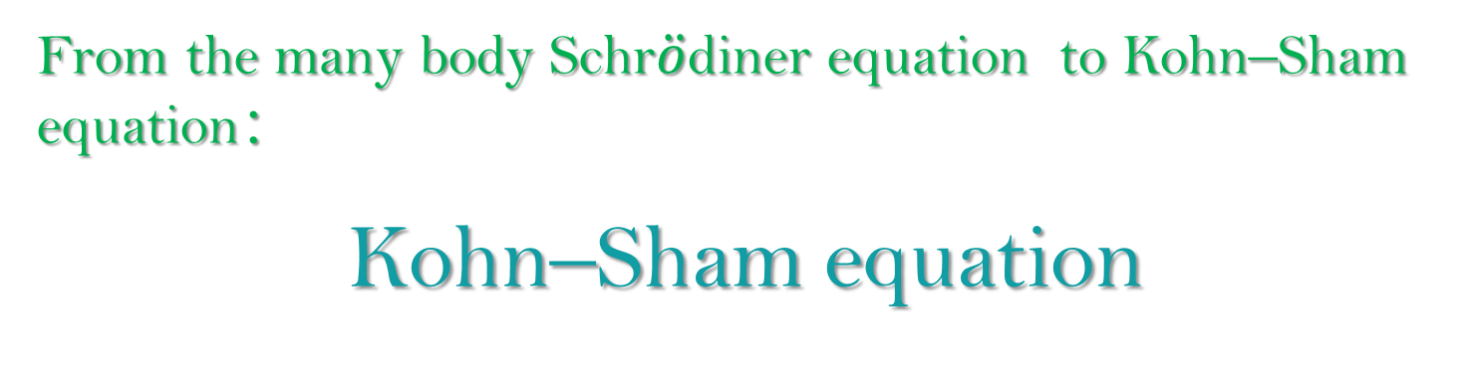
Density Functional Theory
From the many body Schr$\ddot{o}$diner equation to Kohn–Sham equation：
Kohn–Sham equation
Summary
Magnetic
Structure
Electronic
Junfei Ding 17-Sep-2020

Slide 3
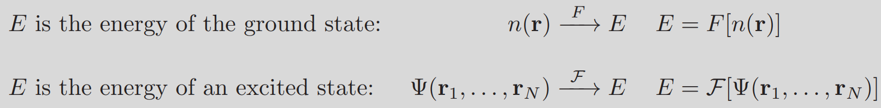
Hohenberg−Kohn theorem
The core concept of density functional theory is the observation that, if E is the lowest possible energy of the system, i.e. the energy of the ground state, then E is a functional of the electron density only:
E = F[n]
Summary
Magnetic
Structure
Electronic

Slide 4
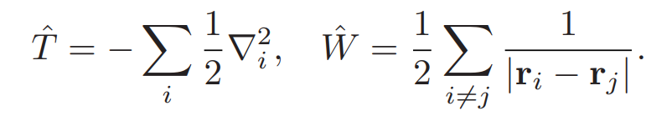
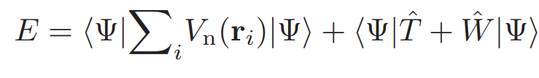
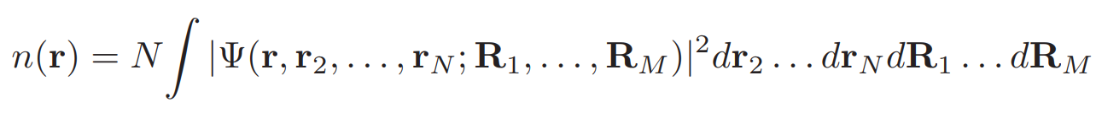
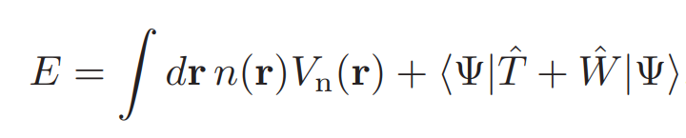

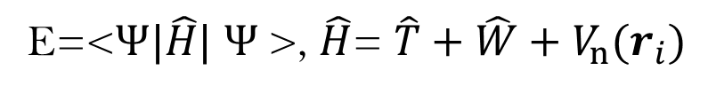
Hohenberg−Kohn theorem
The idea is to start from the assumption that the same ground-state electron density can be obtained from two different external potentials, and show that this leads to a contradiction
E=<$Ψ|\hat{H}|$ $Ψ$>, $\hat{H}$= $\hat{T}+$ $\hat{W}+V_{n}(r_{i})$
Summary
Magnetic
Structure
Electronic

Slide 5
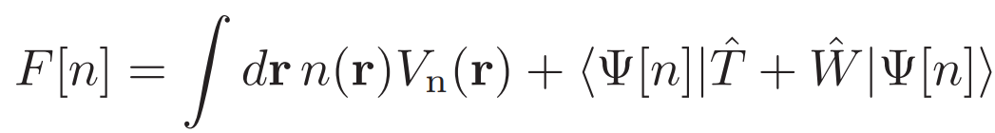
Kohn–Sham equations
The Hohenberg–Kohn theorem tells us that the total energy of many electrons in their ground state is a functional of the electron density.
However, this theorem does not say anything about how to construct such functional.
Summary
Magnetic
Structure
Electronic
We can certainly rewrite this functional as follows:
Here we see that the first term in the functional is already explicitly dependent on the density, n; however, there are two extra terms (kinetic energy and Coulomb energy) for which the dependence on the density is only implicit.

Slide 6
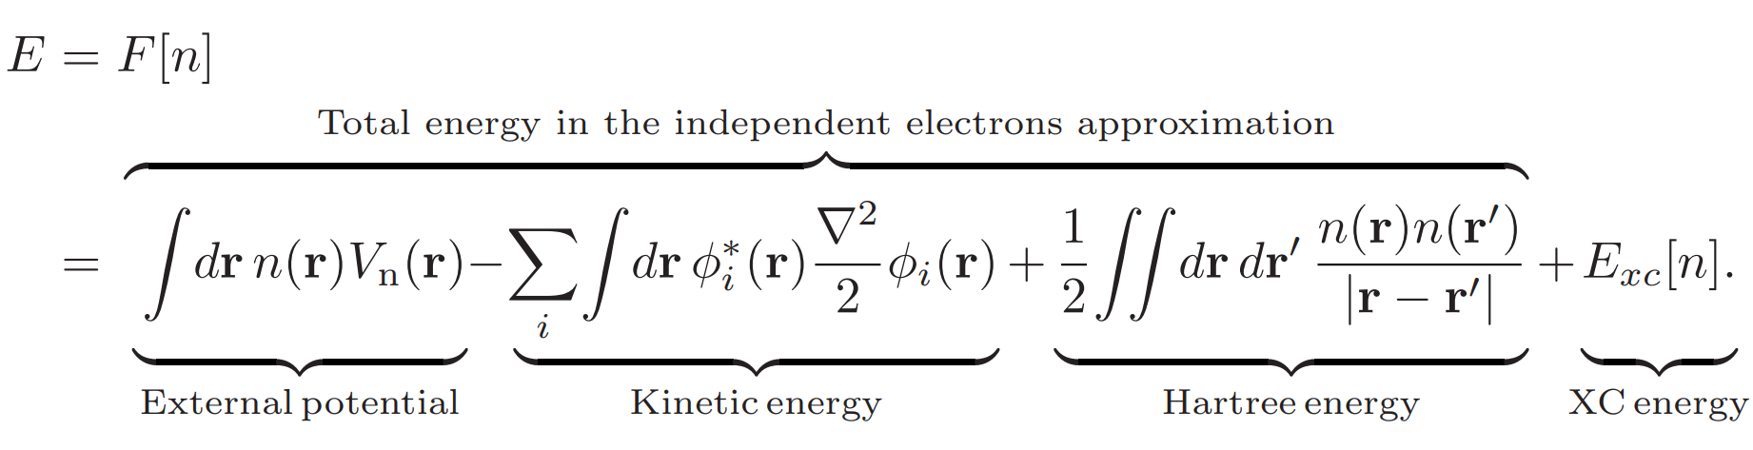
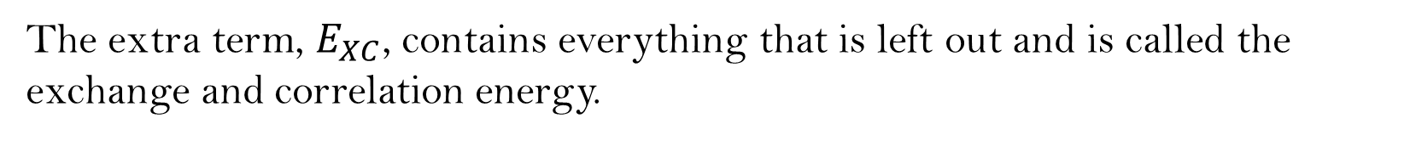
Kohn–Sham equations
The idea of Kohn and Sham (1965) was to split these implicit terms into the kinetic and Coulomb energy of independent electrons , plus an extra term which accounts for the difference:
Summary
Magnetic
Structure
Electronic
The extra term, $E_{XC}$, contains everything that is left out and is called the exchange and correlation energy.

Slide 7
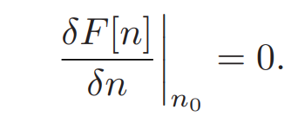

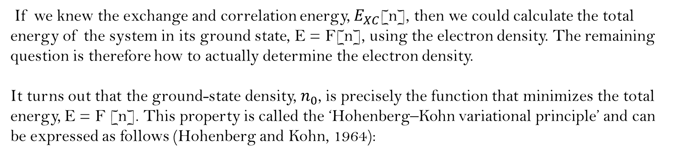
Kohn–Sham equations
If we knew the exchange and correlation energy, $E_{XC}$[n], then we could calculate the total energy of the system in its ground state, E = F[n], using the electron density. The remaining question is therefore how to actually determine the electron density.
It turns out that the ground-state density, $n_{0}$, is precisely the function that minimizes the total energy, E = F [n]. This property is called the ‘Hohenberg–Kohn variational principle’ and can be expressed as follows (Hohenberg and Kohn, 1964):
Summary
Magnetic
Structure
Electronic
The density, n(r), is expressed in terms of the (yet unknown) Kohn–Sham wavefunctions, ${\text{ψ}}_{i}$(r)

Slide 8
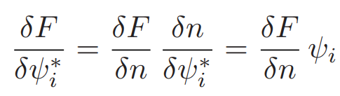

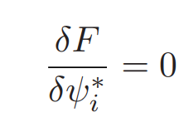
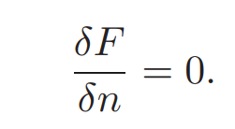

Kohn–Sham equations
If we apply the chain rule to the functional derivative of F with respect to any of the wavefunctions,${\text{ψ}}_{i}^{∗}$ , we find:
Summary
Electronic
Magnetic
Structure
The Kohn–Sham wavefunctions satisfy the orthonormality constraints:

Slide 9
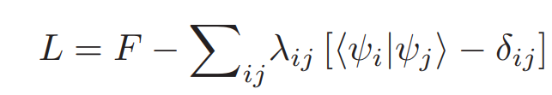
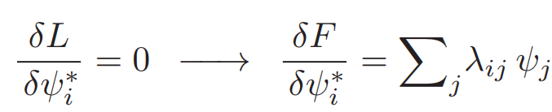
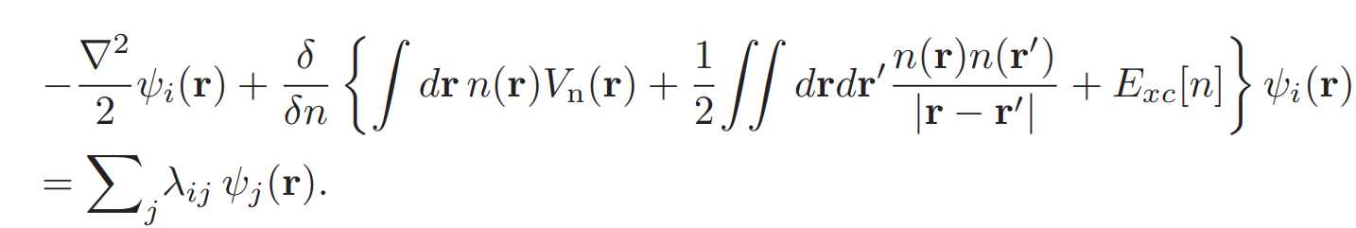

Kohn–Sham equations
Lagrange functional:
Summary
Magnetic
Structure
$$\frac{δF}{δψ_{i}^{∗}}=\frac{δF}{δn}\frac{δn}{δψ_{i}^{∗}}=\frac{δF}{δn}ψ_{i}$$
Electronic

Slide 10
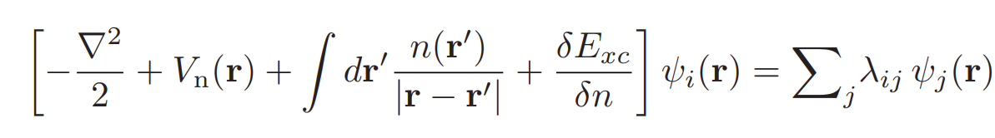
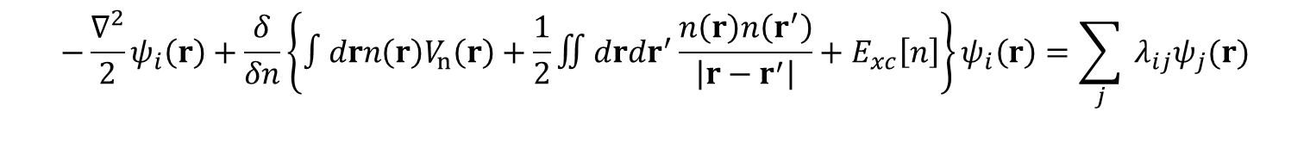
Kohn–Sham equations
$$−\frac{∇^{2}}{2}ψ_{i}\left(r\right)+\frac{δ}{δn}\left\{∫drn\left(r\right)V_{n}\left(r\right)+\frac{1}{2}∬drdr^{′}\frac{n\left(r\right)n\left(r^{′}\right)}{\left|r−r^{′}\right|}+E_{xc}\left[n\right]\right\}ψ_{i}\left(r\right)=\sum_{j}{ }λ_{ij}ψ_{j}(r)$$
Summary
Magnetic
Structure
Electronic

Slide 11
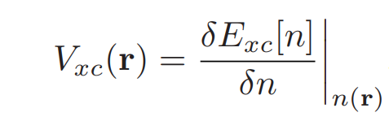
Kohn–Sham equations
The extra term,$V_{XC}$ , is given by:
and is called the exchange and correlation potential.
The set of the above equations are called Kohn–Sham equations and form the basis of the Kohn–Sham theory (Kohn and Sham, 1965)
This set of equations constitutes a very powerful tool for calculating many properties of materials starting from the first principles of quantum mechanics.
Summary
Magnetic
Structure
Electronic

Slide 12

Kohn–Sham equations
Kohn’s Nobel Prize lecture (Kohn, 1999):
‘The Kohn–Sham theory may be regarded as the formal exactification of Hartree theory. With the exact $E_{XC}$ and $V_{XC}$ all many-body effects are in principle included. Clearly this directs attention to the functional $E_{XC}$[n]. The practical usefulness of ground-state DFT depends entirely on whether approximations for the functional $E_{XC}$[n] could be found, which are at the same time sufficiently simple and sufficiently accurate.’
Summary
Magnetic
Structure
Electronic

Slide 13
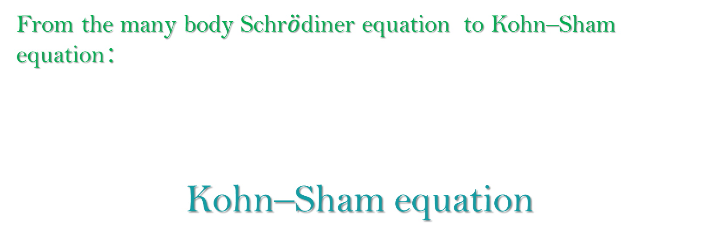
Density Functional Theory
From the many body Schr$\ddot{o}$diner equation to Kohn–Sham equation：
Kohn–Sham equation
Summary
Magnetic
Structure
Electronic
Junfei Ding 17-Sep-2020

